Slide 1




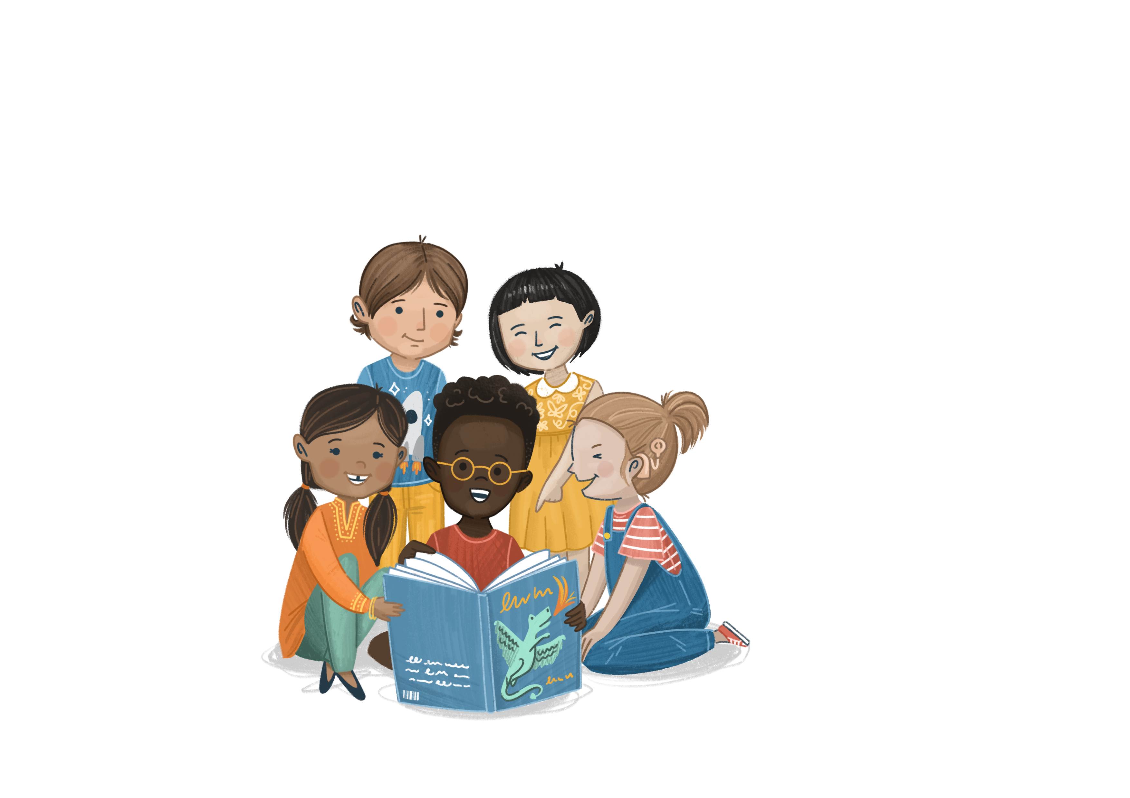


In partnership with
Welcome to
©The Story Project CIC

Slide 2
Lesson 1

Slide 3
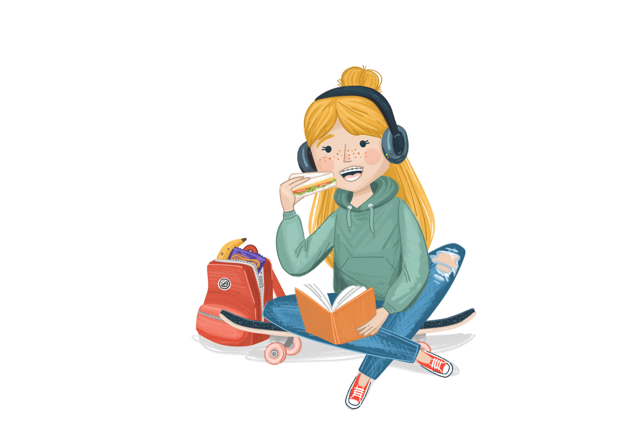
Ground Rules
Story Project lessons are a safe space for everyone to share their ideas.
How can we make sure we all feel comfortable to speak?
Notes:
Before beginning, talk to the children about The Story Project being a safe space for open discussion where children should feel safe to express themselves.
Establish some ground rules about how you will create and maintain the safe space.
Ground rule suggestions:
We listen to everyone’s opinions respectfully
We join in with the lesson calmly
It is ok to have different opinions and ideas
We are inquisitive and excited to learn
If we are worried about something, we talk to a trusted adult
If we are worried about a friend or ourselves, we talk to a trusted adult
We do not have to talk about a topic that upsets us
We have fun!

Slide 4





Our Book
Title: Zlata’s Diary
Author: Zlata Filipovic
ISBN Number: 9780140374636

Slide 5

‘5-5-5 breathing’
ettle
Let’s get ready for our lesson by spending a few minutes settling ourselves…
Close your eyes and listen to the music.
Notes:
‘5-5-5 Breathing’ (from the International Rescue Committee’s Mindful Moments Resource
Play peaceful music or put a calming image on the board.
Breathe in for 5 seconds, hold for 5 and breathe out for 5.
Repeat until you feel calmer

Slide 6
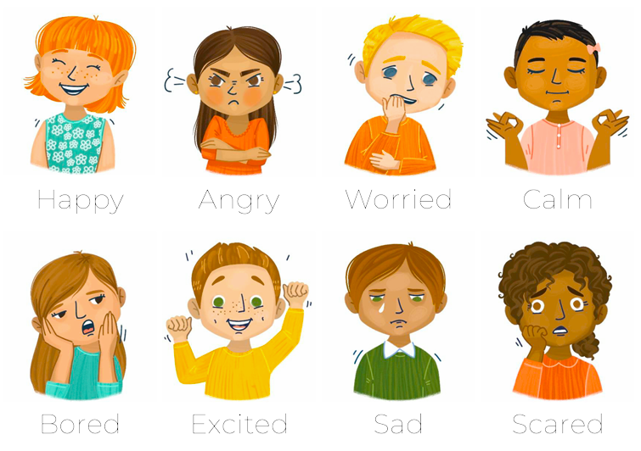
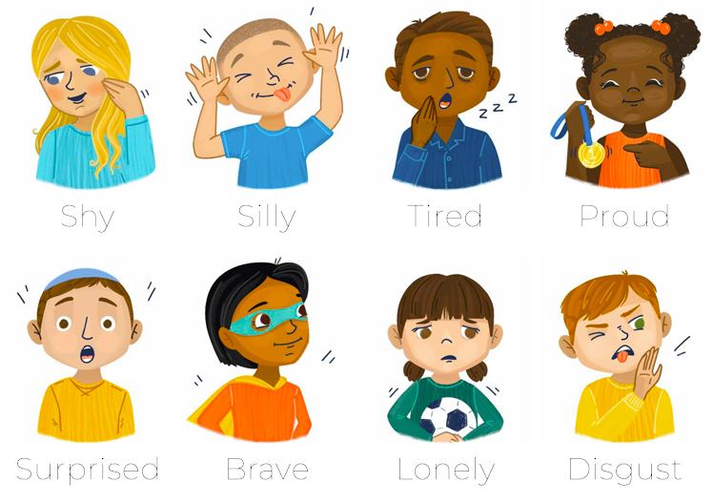
Emotional Vocabulary
How do you think Zlata feels in the photo on the front cover?
Can you predict what will happen in the story?
raining
Notes:
Look at the picture on the front of the book.
How do they think Zlata is feeling here?
Can pupils predict what this story might be about?

Slide 7

I can describe some of the ways war can affect children, including their human rights.
bjective

Slide 8
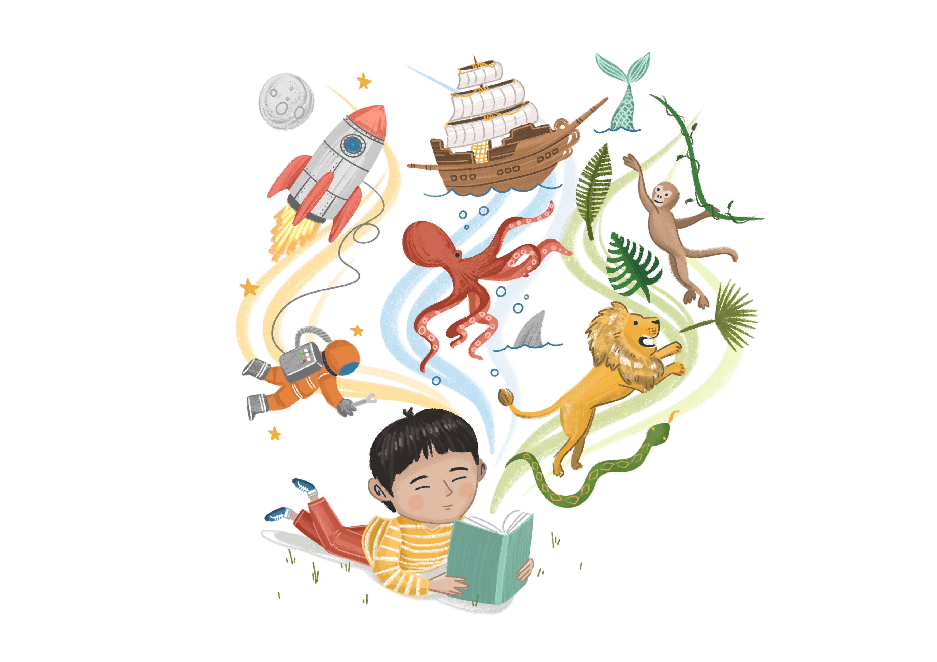
Enjoy the Story
Vocabulary:
Why do you think Zlata chose to write “I keep thinking we’re alone in this hell”? What did she mean?
Retrieval:
Can you think of two examples of things Zlata had once she moved to Paris?
How did Zlata and her family manage to leave Sarajevo?
Inference:
Why do you think Zlata and her family cried when they saw their friend Janine holding ‘an armful of food’?
How do you think Zlata and her family felt when they finally arrived in Paris?
ead
Notes:
Can you think of two examples of things Zlata had once she moved to Paris?
e.g. electricity, coca cola, hot water etc

Slide 9
Class Discussion
What do you think…
How do you think children around the world are affected by war?
ou
Notes:
Notes for teachers
There are no right or wrong answers here; the value comes in pupils’ discussion and ideas.
Think about Zlata’s experiences of war in Sarajevo and how it affected her life. Ask children if they know of any other wars around the world. Some might know a little about the Ukraine Russia or the conflict in Gaza. This video may be helpful - https://www.bbc.co.uk/newsround/67145852 to help contextualise the experience of war on children and their families.
Think about some of the key ‘Rights of the Child’ (https://www.unicef.org.uk/what-we-do/un-convention-child-rights/), and ask children which of these rights they think are affected during a war –
Every child has the right to:
Relax and play (Article 31)
Freedom of expression (Article 13)
Be safe from violence (Article 19)
An education (Article 28)
Protection of identity (Article 8)
Sufficient standard of living (Article 27)
Know their rights (Article 42)
Health and health services (Article 24)
You may wish to end the discussion by reminding children that the UK is safe and not at war.

Slide 10

Activity A
‘Compare and Contrast’
How do you think Zlata’s life changed from before the war to after it?
Work together to put these ideas in order.
In what way were Zlata’s Human Rights affected during the war?
ou
Notes:
Using the worksheet below, give pupils three columns titled ‘before’, ‘during’, ‘after’.
Ask pupils to put information about Zlata’s life in each column, showing how her life changed during the war. Encourage pupils to think about the emotions linked to these scenarios.
Suggested ideas are given in the PPT slides and can be found on the worksheet below, but pupils may also add their own ideas.
Spend two minutes at the end of the session, sharing ideas and talking through pupils’ thoughts. Show them slide 11 and discuss what each ‘right’ means. Which of Zlata’s rights were affected during and after the war?
Extend the activity: research what human rights mean, including the ‘Rights of the Child’.

Slide 11
Activity A
‘Compare and Contrast’
UN Rights of the Child
Every child has the right to:
Relax and play (Article 31)
Freedom of expression (Article 13)
Be safe from violence (Article 19)
An education (Article 28)
Protection of identity (Article 8)
Sufficient standard of living (Article 27)
Know their rights (Article 42)
Health and health services (Article 24)
ou
Notes:
See previous slide

Slide 12
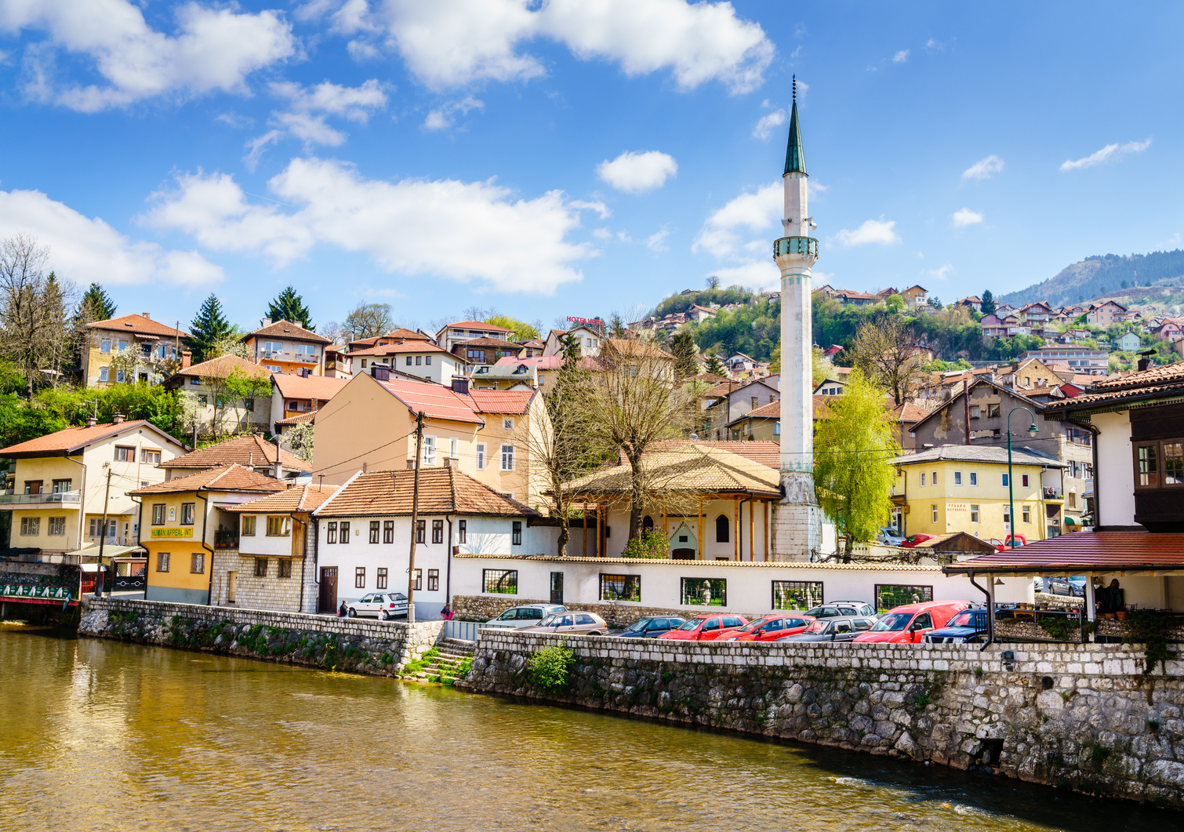
Activity B
Moving House
How would it feel to have to move house, just as Zlata did during the war?
Write your own diary entry thinking about:
What you would find difficult.
What you would miss.
How you would feel.
ou
Notes:
Explain that during a war families are often forced to move, sometimes to another city and sometimes to another country. Start by using an activity such as hot seating or similar, to get children talking about how they would feel if they had to move. Think about – what they would miss, what they would take with them, how it would feel.
Ask children to write their own diary entries as though they have had to move.
If children find this task difficult or emotional, they can write as though they are Zlata – thinking about how she would feel. They can use the photo in the slide as inspiration – a photo of Sarajevo.
At the end, share some of the children’s writing with the class. Talk about how although Zlata’s experience was very difficult, she found a safe place to live with her family.

Slide 13
Lesson 2
Notes:
If necessary, re-introduce the ground rules discussed in the previous lesson.

Slide 14
Our Book
Title: Zlata’s Diary
Author: Zlata Filipovic

Slide 15

Zlata’s Favourite Music
ettle
Let’s get ready for our lesson with an activity to settle our emotions…
Close your eyes and take a deep breath.
Listen to one of Zlata’s favourite pieces of music.
Notes:
Author, Zlata Filipovic, who wrote this book has shared with us her favourite pieces of music to relax to. She particularly enjoys Bach, Chopin, Czerny and Mozart.
Here is a compilation of Chopin from YouTube
Invite pupils to listen to a minute or so of music and think about the instruments they can hear. They can close their eyes if they wish.

Slide 16
Emotional Vocabulary
raining
After reading about Zlata in lesson 1, can you think of the different emotions she might have been feeling during the war?
Notes:
After reading the extracts from lesson 1, can pupils think about some of the emotions Zlata may have been feeling? Can they think of alternative emotional vocabulary to describe her feelings beyond happy, sad, or scared?

Slide 17
I can explain how to be a good neighbour and how to get help in my neighbourhood.
bjective

Slide 18
Enjoy the Story
Retrieval:
What does Zlata pack in her backpack to take to her neighbours? What do you think the ‘few others things’ are?
Why are Zlata’s friends so important to her at this difficult time?
Inference:
How do you think Zlata feels having to run to her neighbour’s house when the shooting starts?
Zlata’s Mum has to learn to make bread without electricity, what other things do you think they might have eaten when the power went out?
ead
Notes:
First, read the blurb so pupils understand the context of the story.
Share Zlata’s diary entries from Tues 21st April to Thurs 26th April, (p35-P37), Sat 23rd May (p47) and Sat 29th August (p74-75) with pupils.
Suggested answers:
What does Zlata pack in her backpack to take to her neighbours? – page 36 - biscuits, juice, a deck of cards and a few others things.
Why are Zlata’s friends so important to her at this difficult time? Page 75 – they help her not to get bored and distract her from the horrible things happening around her.

Slide 19
Class Discussion
What do you think…
What do you think makes a good neighbour?
ou
Notes:
Notes for teachers
There are no right or wrong answers here; the value comes in pupils’ discussion and ideas.
To get the conversation going, first talk about how Zlata’s neighbours were good to each other – they helped provide safety, cooked together and became friends. Then talk about how children’s own neighbours show kindness and respect. They could also think about their talk partners or friends, if they don’t have neighbours they know at home.
Key follow-up questions:
How can children be better neighbours/friends?
How can children stay safe when talking to neighbours? (e.g. telling a trusted adult what they are doing, not going into strangers houses etc).

Slide 20

Activity A
Our School Neighbourhood
In Zlata’s diary, we saw how important her neighbours and friends were to her.
How much do you know about your school neighbourhood? Let’s find out more!
ou
Notes:
For Zlata and her family, the support of their neighbours was vital to their survival and wellbeing during the war. Neighbours and communities are also important around the world – but how much do your pupils know about their own neighbours and community?
In pairs or small groups, invite children to find out more about their classmates. They can use the suggested questions in the PPT slides or come up with their own. Then, invite the class to share some ideas at the front.
Finally, talk about how the community can support each other, considering all the differences and similarities between them. Give additional focus to how we might support somebody new in our community, especially children who are refugees. E.g.
Learn a few words in the new person’s language
Borrow some dual language books from the library
Make sure to pronounce the person’s name properly (ask them if you’re not sure)
Create a welcome box
Extension the learning: Invite a staff member (who lives locally) or a parent to visit the class to talk about their culture, heritage and experiences of living in the community. Pupils can use the suggested questions from the slides to scaffold their questions, if needed.

Slide 21

Activity B
‘It takes a village…’
What do you think this phrase means?
‘It takes a village to raise a child.’
How can we use this phrase to inspire us to be the best neighbours and friends we can be? Let’s find out!
ou
Notes:
Talk to pupils about the phrase ‘It takes a village to raise a child.’ and what this might mean, highlighting the importance of community, teamwork, empathy and shared responsibilities. The phrase shows us that everyone is involved in their community and has a responsibility to it. Explain that this same principle can be applied, not just to children, but to lots of aspects of life, as Zlata and her family found out in her book. E.g. ‘It takes a village to stay safe’
Ask pupils to imagine they have been invited to join a Community Council for their local area. They have been tasked with creating a set of guidelines for living in the community, that ensures 1. Everyone is safe, 2. Everyone is supported, 3. People understand the shared responsibility to look after the neighbourhood, 4. People know where to go to get help and 5. How they will support new people, particularly refugees. Ideas can be found in the PPT slide notes.
Either verbally or written down, put pupils into groups to discuss their ideas. Feedback to the rest of the class.
Extension the learning: Create a flyer to share the pupils’ ideas with the community

Slide 22
Reflection
Notes:
If necessary, re-introduce what The Story Project is about, revisiting previous learning from last week. You may also wish to remind children about any Ground Rules you have agreed together.

Slide 23
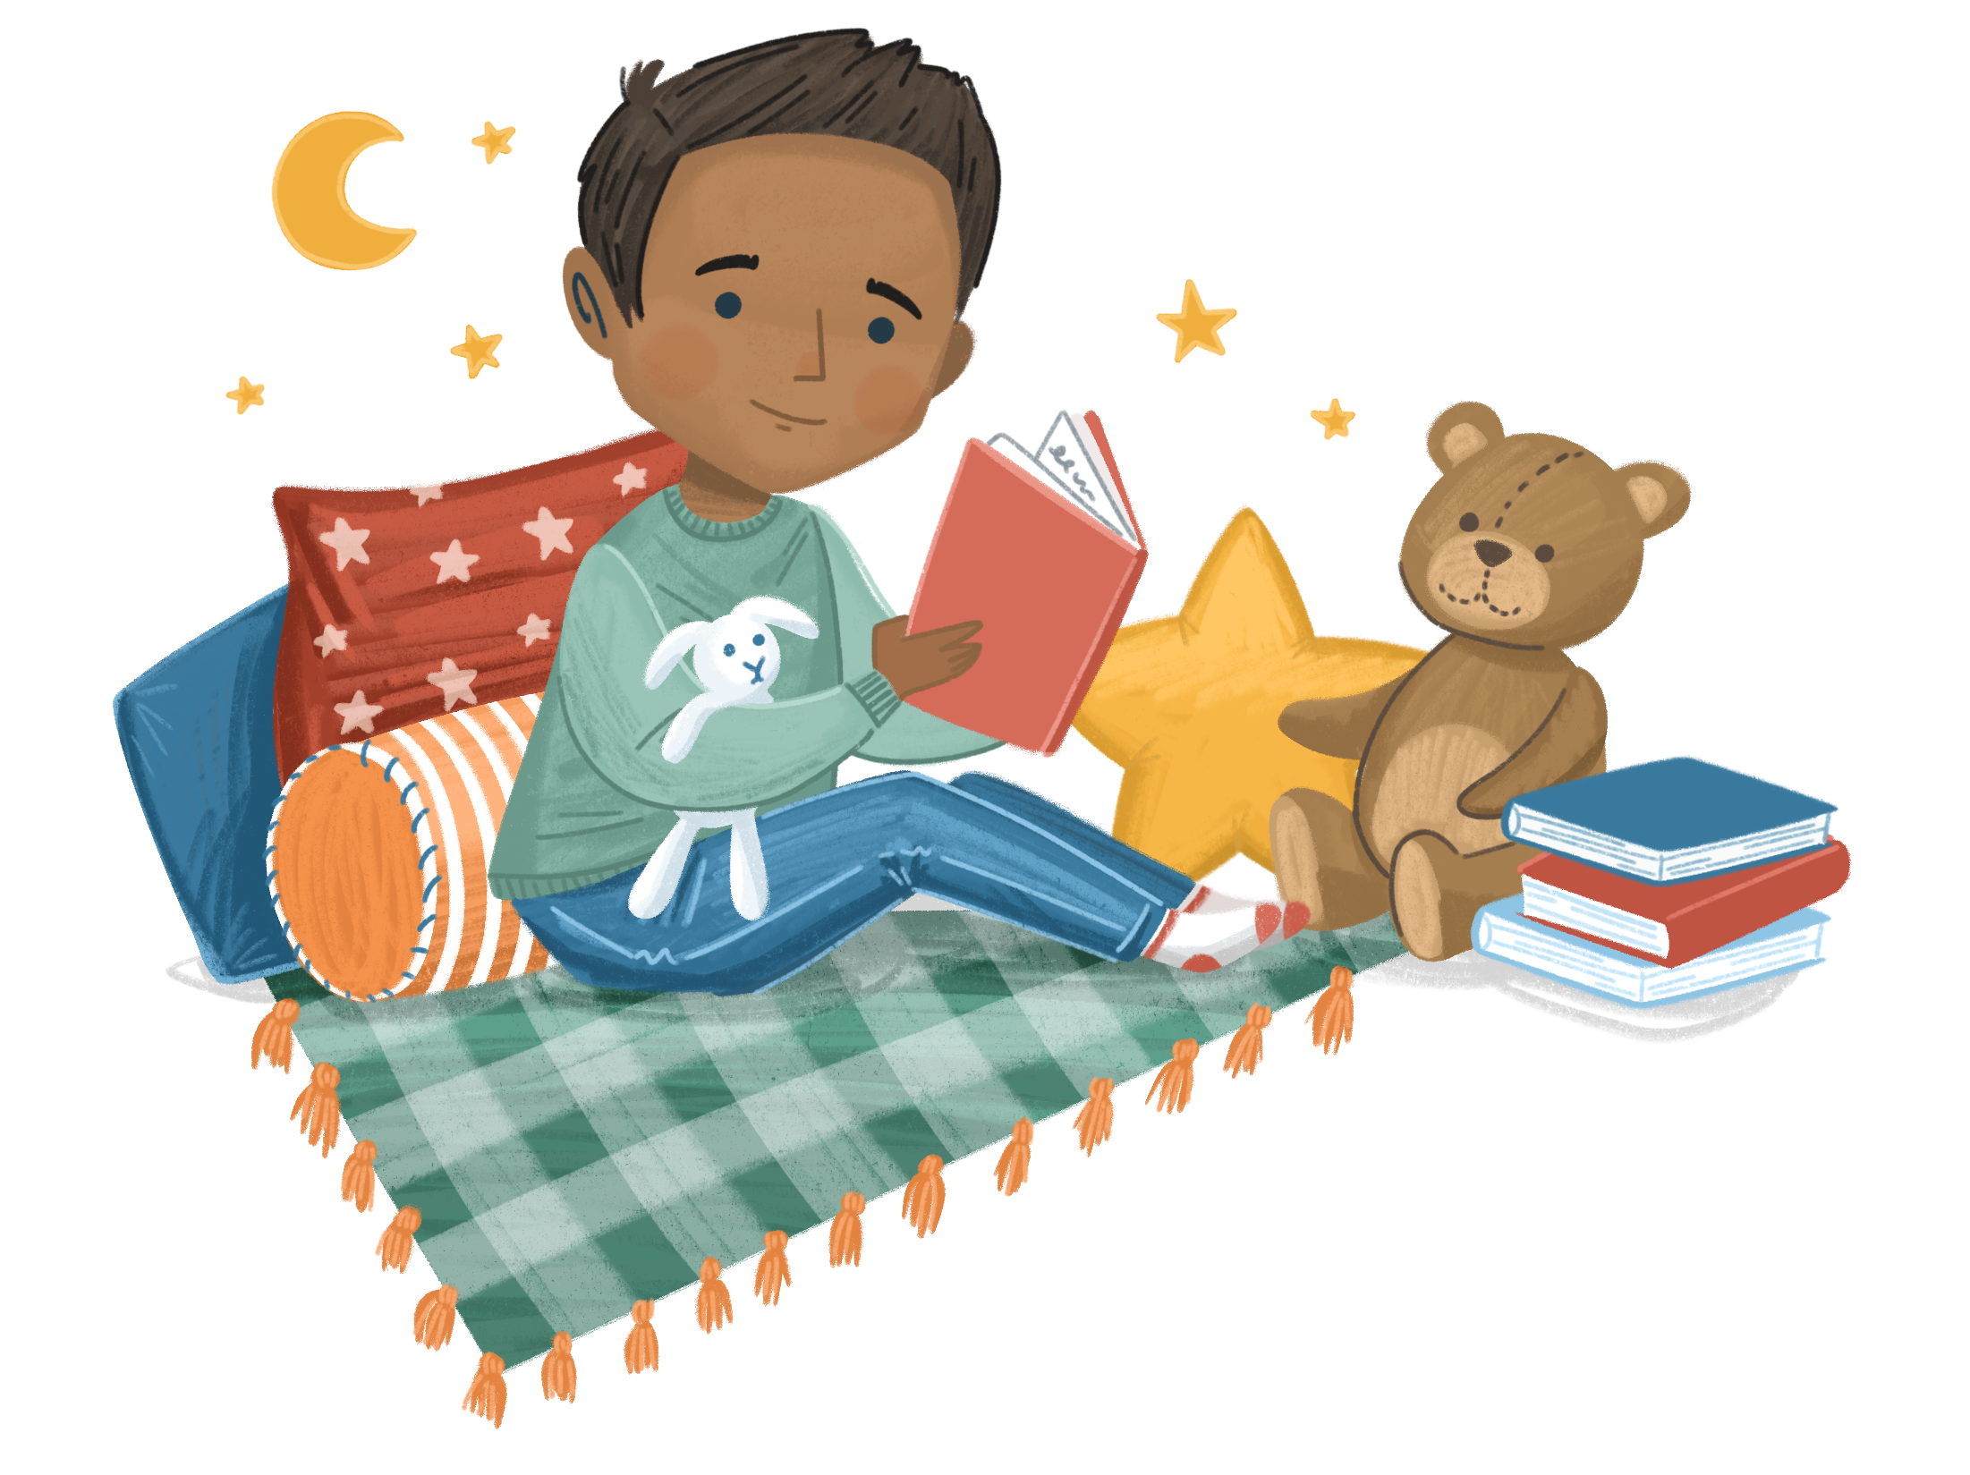
You choose!
ettle
Which was your favourite Settle activity from the last two lessons?
Use it to start your lesson today.
Notes:
Imaginary Hats
Hare Hug

Slide 24
Reflecting on our learning:
I can describe some of the ways war can affect children, including their human rights
I can explain how to be a good neighbour and how to get
help in my neighbourhood.
bjective

Slide 25
Emotional Vocabulary
Which emotions and feelings have we found in the story?
Can you explain what each one means?
raining
Notes:
Which feelings and emotions have you covered
Can the children explain what each feeling and emotion means?
Can they give an example of when they have felt like that themselves?

Slide 26
Summarise the Story
Can you summarise the story to your partner?
What were the key parts in the story?
ead

Slide 27
Class Discussion
Which activities/discussions did you learn the most from?
Is there anything that could have made this unit better?
Was there anything you didn’t enjoy about this unit? Why?
Which were the best activities in the unit? Why?
Have you learnt anything in this unit about wellbeing that you didn’t already know?
Help us share your achievements!
Is there anything you have done or learning as part of this unit that you would like us to shout about on our social media?
ou
Notes:
Teacher to summarise pupil's responses

Slide 28
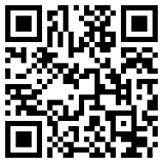
Pupil review of learning
Please summarise children’s answers here:
https://forms.office.com/e/gv0UsCJeTy
ou
Notes:
Teacher to summarise pupil's responses
These will be shared with the Story Project team, your Headteacher and your Story Project Lead teacher.
https://forms.office.com/e/gv0UsCJeTy

Slide 29
Teacher review of learning
Please complete the review here:
https://forms.office.com/e/ePQtyxzyY8
ou
Notes:
This will be shared with the Story Project team, your Headteacher and your Story Project Lead teacher.
https://forms.office.com/e/ePQtyxzyY8

