Slide 1




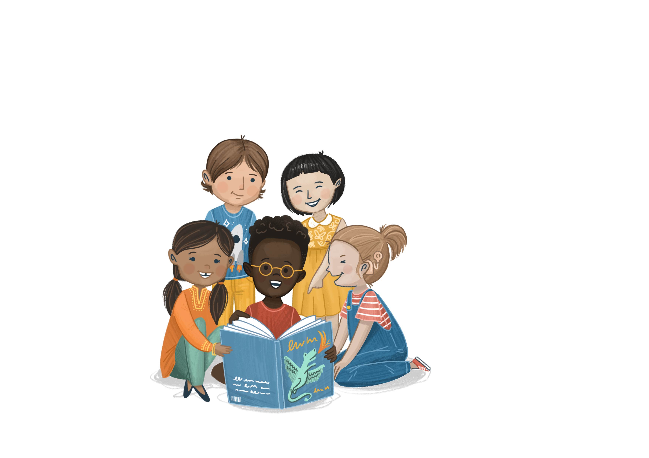


In partnership with
Welcome to
©The Story Project CIC

Slide 2
Lesson 1

Slide 3
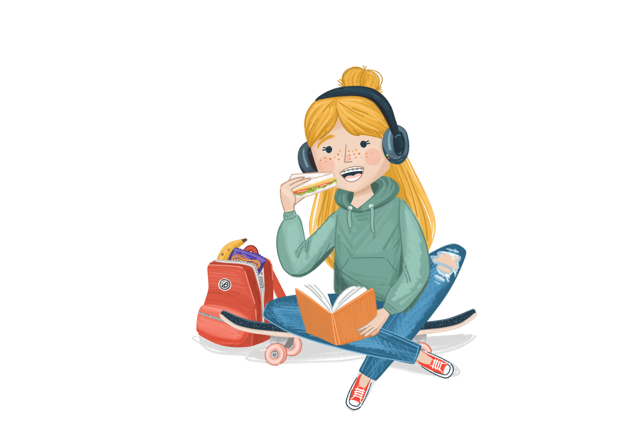
Ground Rules
Story Project lessons are a safe space for everyone to share their ideas.
How can we make sure we all feel comfortable to speak?
Notes:
Before beginning, talk to the children about The Story Project being a safe space for open discussion where children should feel safe to express themselves.
Establish some ground rules about how you will create and maintain the safe space.
Ground rule suggestions:
We listen to everyone’s opinions respectfully
We join in with the lesson calmly
It is ok to have different opinions and ideas
We are inquisitive and excited to learn
If we are worried about something, we talk to a trusted adult
If we are worried about a friend or ourselves, we talk to a trusted adult
We do not have to talk about a topic that upsets us
We have fun!

Slide 4







Our Book
Title: Everybody’s Welcome
Author: Patricia Hegarty
Illustrator: Greg Abbott

Slide 5
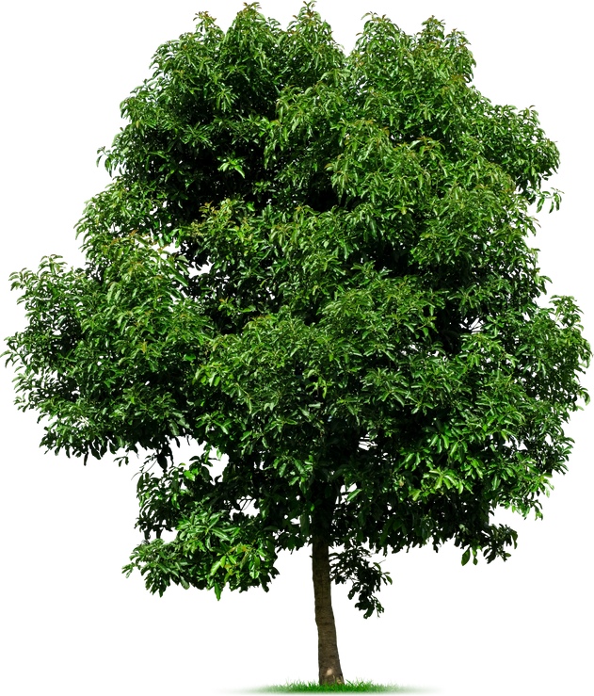
We Are All Trees
ettle
Let’s get ready for our lesson with an activity to settle our emotions…
Close your eyes and take a deep breath
Notes:
Guide children from a ‘mindful moments’:
Take a deep breath in and out. Close your eyes
Imagine you are a tall, strong tree standing in the middle of a wide-open field, with a gentle, warm breeze passing through
Imagine your legs are the trunk of the tree, keeping you standing tall no matter what gets in your way.
Imagine your arms are the branches. Reach them up as high as you can. Stretch them out as wide as you can. Feel the space you are taking up in the room
Imagine your fingers are the leaves. Notice how they feel. Is there a breeze? Are they warm or cold?
Focus back on your breathing. Focus on the calmness of the room.
Take another deep breath in and out.
Slowly, open your eyes.

Slide 6
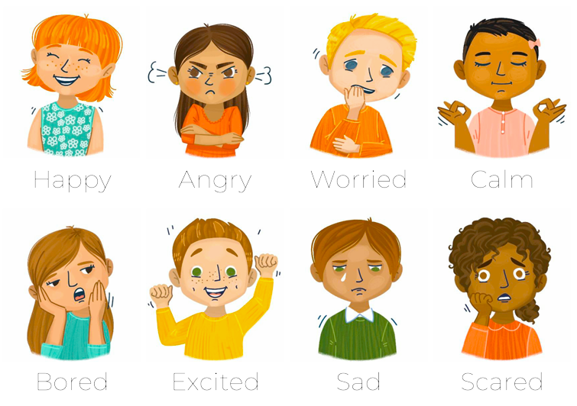
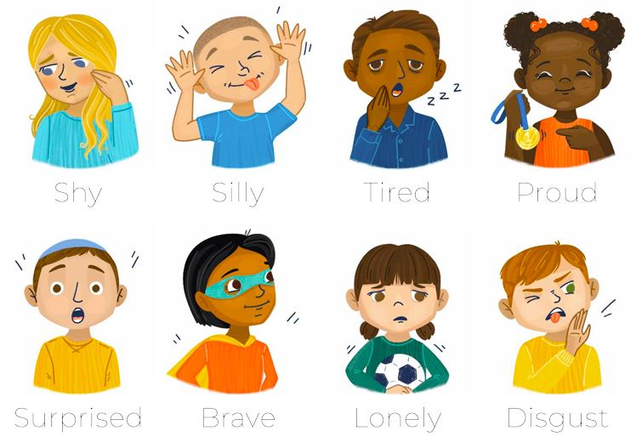
Emotional Vocabulary
How the animals feeling on page 2?
How do you know?
raining
Notes:
Look at the picture of the mouse and the frog on page 2 (where the mouse looks concerned and the frog looks sad)
How do the pupils think the two animals are feeling?
What do children think will happen next? Do you think the mouse will help the frog? How do they know?

Slide 7

I can explain how I welcome new people into my classroom.
bjective

Slide 8
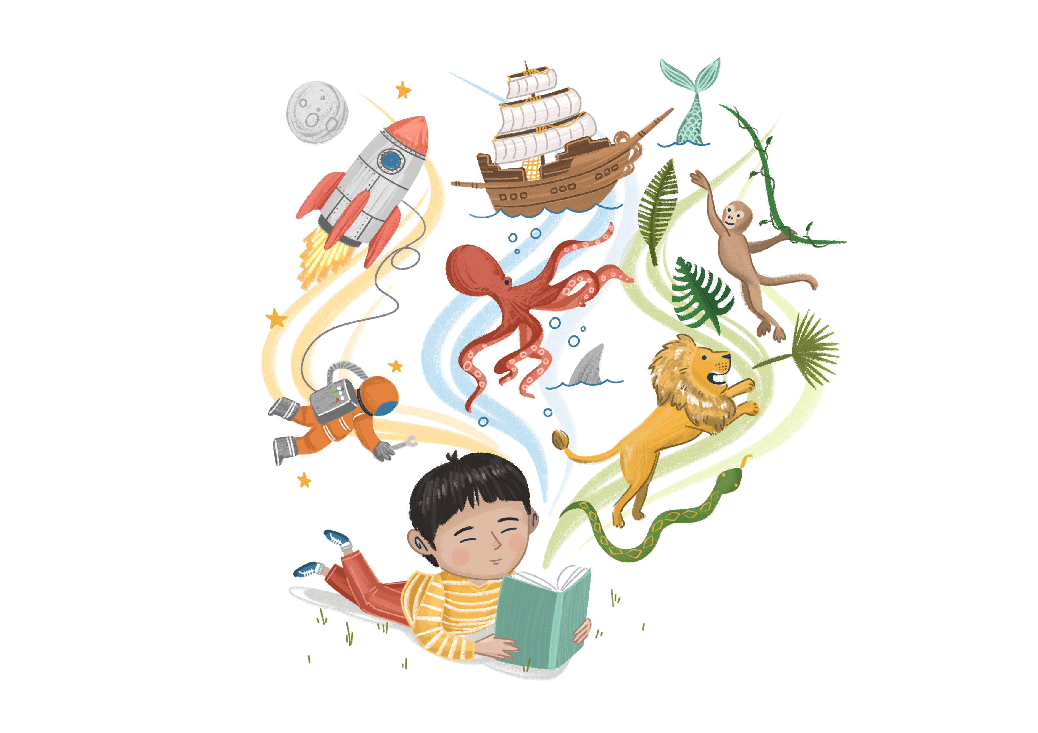
Enjoy the Story
Vocabulary:
What does ‘sorry tale of woe’ mean? (page 2)
Retrieval:
Can you think of an example of why the animals are looking for a new place to live?
Inference:
How does Mouse welcome other animals?
Why do you think Mouse is glad that an animal like Bear has come along? (p9). How do you think Bear feels after he is welcomed by Mouse?
Do you think the animals all feel welcomed in their new home, by the end of the story?
ead
Notes:
Suggested answers and prompts:
Can you think of an example of why the animals are looking for a new place to live?
Frog – pond has dried up. Rabbits – scared away by an eagle. Bear – scared people away due to his size. Birds – tree has been chopped down.
How does Mouse welcome other animals?
No matter who the animals are, where they have come from or why Mouse welcomes them with open arms. Mouse invites them to join in building the new home, meaning they are all involved and valued members of the team. Keep an eye on the illustrations throughout the book, as there are lots of lovely examples of how the animals support each other and show kindness.
Why do you think Mouse is glad that an animal like Bear has come along? (p9). How do you think Bear feels after he is welcomed by Mouse?
Bear was worried about scaring people away due to his height. However, Mouse sees Bear’s height as a strength – it means he can reach up high. Mouse values all the animals differences. This is likely to make Bear feel welcomed, listened to and understood.
Do you think the animals all feel welcomed in their new home, by the end of the story? How do you know?
The animals have worked hard together to build their home. The illustrations show them as happy, being friendly and helping each other. Encourage children to think about how different the animals are – yet they all live together harmoniously.

Slide 9
Class Discussion
What do you think…
Why is it important to help each other in our class?
ou
Notes:
Notes for teachers
There are no right or wrong answers here; the value comes in pupils’ discussion and ideas.
Encourage children to think about their own experiences – times they needed help and times they helped other people in class. Link this back to the book, highlighting how the animals all helped each other and how they celebrated each other’s differences and similarities. If any children have started in your class recently, you could draw on their experience (if they are happy to talk about it).
Key follow up questions:
How does helping people making you feel?
How do you think it makes the other person feel?
How do you feel when somebody helps them?
Benefits to helping other people:
- Feeling good about ourselves, we have done something positive for somebody else
Better teamwork
Better relationships (e.g. stronger friendships when we help each other)
Everybody feels supported and included. Nobody is left out.
Helps us to understand other people’s needs.
Discussion extension
You can extend the discussion by thinking about the reasons people might not ask for help – they could be shy, embarrassed, unsure what to say or who to ask, new and feel alone. Can children think of examples when they have felt like this? What advice would they give to others who feel this way? How would they support a new children in class?

Slide 10
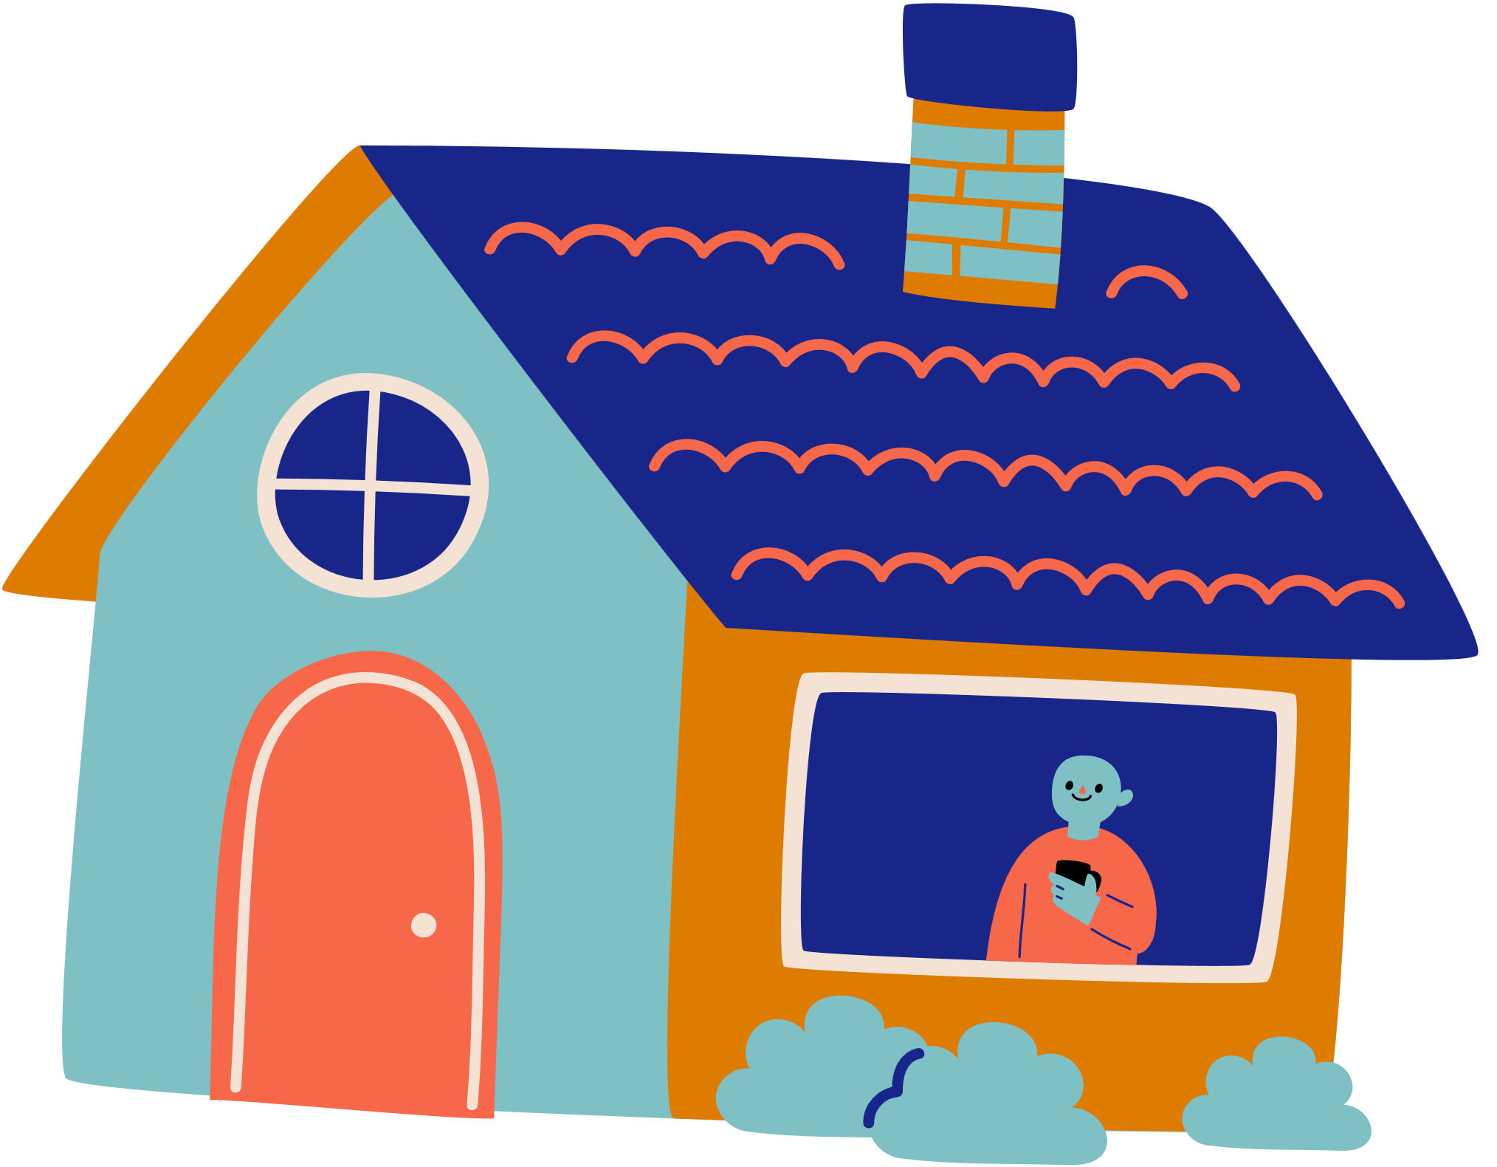
Activity A
A Shelter for Everyone
Pretend you are like the mouse in the story and your classmates are the other animals.
How will you create a shelter that supports everyone’s interests and needs?
ou
Notes:
Ask children to design a shelter (just like the animals do in the story) that accommodates everyone in the class. You can do this verbally together as a class/assembly or in small groups with paper and pen.
Children must consider:
Practicalities e.g. enough room for sleeping, eating, going to the bathroom, accessibility for people with disabilities
Shared interests e.g. some children like football, some like reading, how will they make it a nice space for everyone?
Cultural, religious and language differences e.g. does there need to be a space to pray, how will people communicate if they speak different languages?
If you are doing this activity in a classroom, you could use building blocks or Lego to help children play out the space.
Finally, ask children WHY they think it is important to accommodate everyone? Why should we make sure all children are included and planned for?

Slide 11

Activity B
Welcome Box
Imagine a new child is starting in your class.
Create a ‘welcome box’ to help them settle in.
Why would these items help new children to feel welcomed?
ou
Notes:
In the story, the mouse and the animals work hard to make sure everyone is included when they arrive asking for help.
Ask children to imagine a new child is starting in their class. Can they create a welcome box to help the children settle in. Possible ideas include:
Map of school, pencil case, photos/names of classmates and key adults, welcome pictures draw by the class, a book/dual language book, a small toy, a timetable of the day etc)
Talk about how each item would help somebody to settle into a new class. What can children in class do to welcome the new person? (e.g. Learn a few words in their language, in EYFS adding familiar items to the home corner, learn how to pronounce the child’s name correctly)

Slide 12
Lesson 2
Notes:
If necessary, re-introduce what The Story Project is about, revisiting previous learning from last week. You may also wish to remind children about any Ground Rules you have agreed together.

Slide 13
Our Book
Title: Everybody’s Welcome
Author: Patricia Hegarty
Illustrator: Greg Abbott

Slide 14
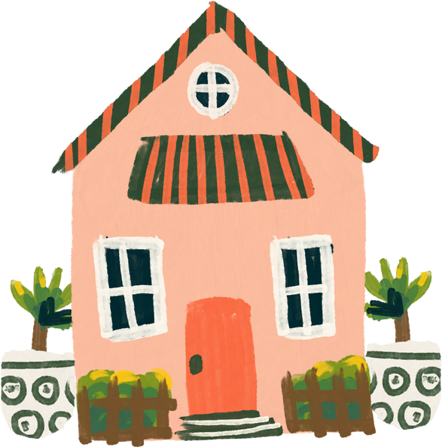
‘My Happy Place’
ettle
Think about your favourite place in the whole world.
Notes:
Ask children to think of their favourite place in the world (home, the park, school etc). Guide them through the following:
Hold up your hand in front of your face. Look at your five fingers and think of five things you can see in your happy place.
Put one finger down and think of 4 things you can touch.
Put one finger down and think of 3 things you can hear.
Put one finger down and think of 2 things you can smell.
Look at your remaining finger and think of 1 thing you can taste.
Share some examples together.

Slide 15
Emotional Vocabulary
How are the animals on page 20 feeling?
Do you think they make a good team? How do you know?
raining
Notes:
Look at the image of the animals working together on the wooden scaffolding on page 20
How do children think the animals are feeling? Do they think they make a good team? – highlight that everyone is involved and has a part to play in the team. They are all looking after each other.

Slide 16
I can explain how I show respect and kindness to others
bjective

Slide 17
Enjoy the Story
Vocabulary:
What do you think ‘If we all work together, no task is too great’ means? (page 12)
Retrieval:
Look at the illustration on p12, of the little snail apologising to the mouse – how can you tell that the mouse has accepted the snail’s apology? How do you think they show kindness to each other?
Find 3 other examples of animals showing kindness to each other in the illustrations.
Inference:
The animals work as a team to create their new home – how do you think they showed respect and kindness to each other while they were building?
ead
Notes:
Suggested answers and prompts:
What do you think ‘If we all work together, no task is too great’ means? (page 12)
Ensure children understand the meaning behind this statement – the importance of teamwork, and how working together can help us to achieve something. If we help each other, showing respect and kindness, just as the animals do in the story, it is much easier to succeed!
Look at the illustration on p12, of the little snail apologising to the mouse – how can you tell that the mouse has accepted the snail’s apology? How do you think they show kindness to each other?
The mouse’s body language shows him opening his arms, as if to hug the snail or welcome him to the house they are building. They are showing kindness and respect by being polite and friendly to each other. There are lots of examples of kindness in the detail of the illustrations – point them out as you go through the story.
The animals work as a team to create their new home – how do you think they showed respect and kindness to each other while they were building?
Look at the illustrations to help with ideas – there is lots of wonderful delete in the pictures that show how the animals help each other. Some possible ideas to pick out:
Teamwork (lots of examples of this in the illustrations for children to notice)
Valuing everybody’s differences and skills (notice in the illustrations how different sized animals are doing things differently – they each celebrate their own unique skills).
Helping to cheer each other up
Listening, taking turns, kind hands
Sharing
Being a good friend

Slide 18
Class Discussion
What do you think…
Why is respect important?
ou
Notes:
Notes for teachers
There are no right or wrong answers here; the value comes in pupils’ discussion and ideas.
Focus children’s discussion on how we respect each other (kind hands, listening, being a good friend etc) and why this is important. How would they like to be treated and how do they think others should be treated.
Ensure children also talk about how we respect people who are different from ourselves. Why is it important to ensure everyone feels respected and listened to, even when they beliefs or backgrounds may be different from our own.
Discussion extension
Thinking about the story, how do children know that all the animals respect each other? In what ways do they show respect?

Slide 19

Activity A
‘RESPECT’
Let’s create a poem or a poster all about the word respect.
Remember: think about why and how we should respect each other.
ou
Notes:
R – Reach out to help others, Respond kindly, Remember manners, Right to learn,
E – Ears for listening, Everyone is welcome, Eye contact, Enjoy time with our friends, Exchange and share ideas, Enthusiastic friend
S – Safety first, Smile, Sensitivity to other people’s ideas, Say sorry when you’ve made a mistake, Share ideas
P – Play together, Polite manners, Pause to listen to others,
E – Ears for listening, Everyone is welcome, Eye contact, Enjoy time with our friends, Exchange and share ideas, Enthusiastic friend
C – Care about others, Curiosity, Community, Caring hands, Classmates together, Compassion, Celebrate differences,
T – Treat others kindly, Trust, Think carefully, Talk kindly, Take turns,

Slide 20
Activity B
‘What would mouse do?’
How would Mouse respond to each of these scenarios, showing kindness and respect?
Umar makes a mistake in front of the whole class. He feels really embarrassed.
Sara has just arrived in the UK from another country. She is nervous about making friends.
ou
Notes:
Each animal in the story is different, but each one is welcomed into the home they are building. Some animals are sad or scared when they arrive, some need extra help, or some just want to be part of the group. Ask children to imagine that they are mouse, meeting different people who need help. What would mouse do in each scenario?
Show them the list of scenarios (in the slides or printable version below) and ask them to decide how they would respond to each child. They must focus on showing respect and kindness so that everyone feels welcome.
Extend the activity by turning this into a role play, asking children to stand up and act out each scenario with volunteers showing how they would respond.
Ensure children understand that there are things they can do to help, but that they can also talk to a trusted adult about it too.

Slide 21
Activity B
‘What would mouse do?’
Caitlyn is upset on the playground and is standing alone.
David joined school a few months ago. He speaks a little bit of English but doesn’t have many people to talk to.
ou
Notes:
Each animal in the story is different, but each one is welcomed into the home they are building. Some animals are sad or scared when they arrive, some need extra help, or some just want to be part of the group. Ask children to imagine that they are mouse, meeting different people who need help. What would mouse do in each scenario?
Show them the list of scenarios (in the slides or printable version below) and ask them to decide how they would respond to each child. They must focus on showing respect and kindness so that everyone feels welcome.
Extend the activity by turning this into a role play, asking children to stand up and act out each scenario with volunteers showing how they would respond.
Ensure children understand that there are things they can do to help, but that they can also talk to a trusted adult about it too.

Slide 22
Activity B
‘What would mouse do?’
May loves football and supports a team from her home country. She really wants to talk about football with the rest of the class but doesn’t know that much about teams in the UK.
Joshua has a different religion to other children in his class. He wants to share his beliefs with his friends but is unsure what to say.
ou
Notes:
Each animal in the story is different, but each one is welcomed into the home they are building. Some animals are sad or scared when they arrive, some need extra help, or some just want to be part of the group. Ask children to imagine that they are mouse, meeting different people who need help. What would mouse do in each scenario?
Show them the list of scenarios (in the slides or printable version below) and ask them to decide how they would respond to each child. They must focus on showing respect and kindness so that everyone feels welcome.
Extend the activity by turning this into a role play, asking children to stand up and act out each scenario with volunteers showing how they would respond.
Ensure children understand that there are things they can do to help, but that they can also talk to a trusted adult about it too.

Slide 23
Activity B
‘What would mouse do?’
A
B
ou
Notes:
Space to add your own specific scenarios relevant to your unique class and content.

Slide 24
Reflection
Notes:
If necessary, re-introduce what The Story Project is about, revisiting previous learning from last week. You may also wish to remind children about any Ground Rules you have agreed together.

Slide 25
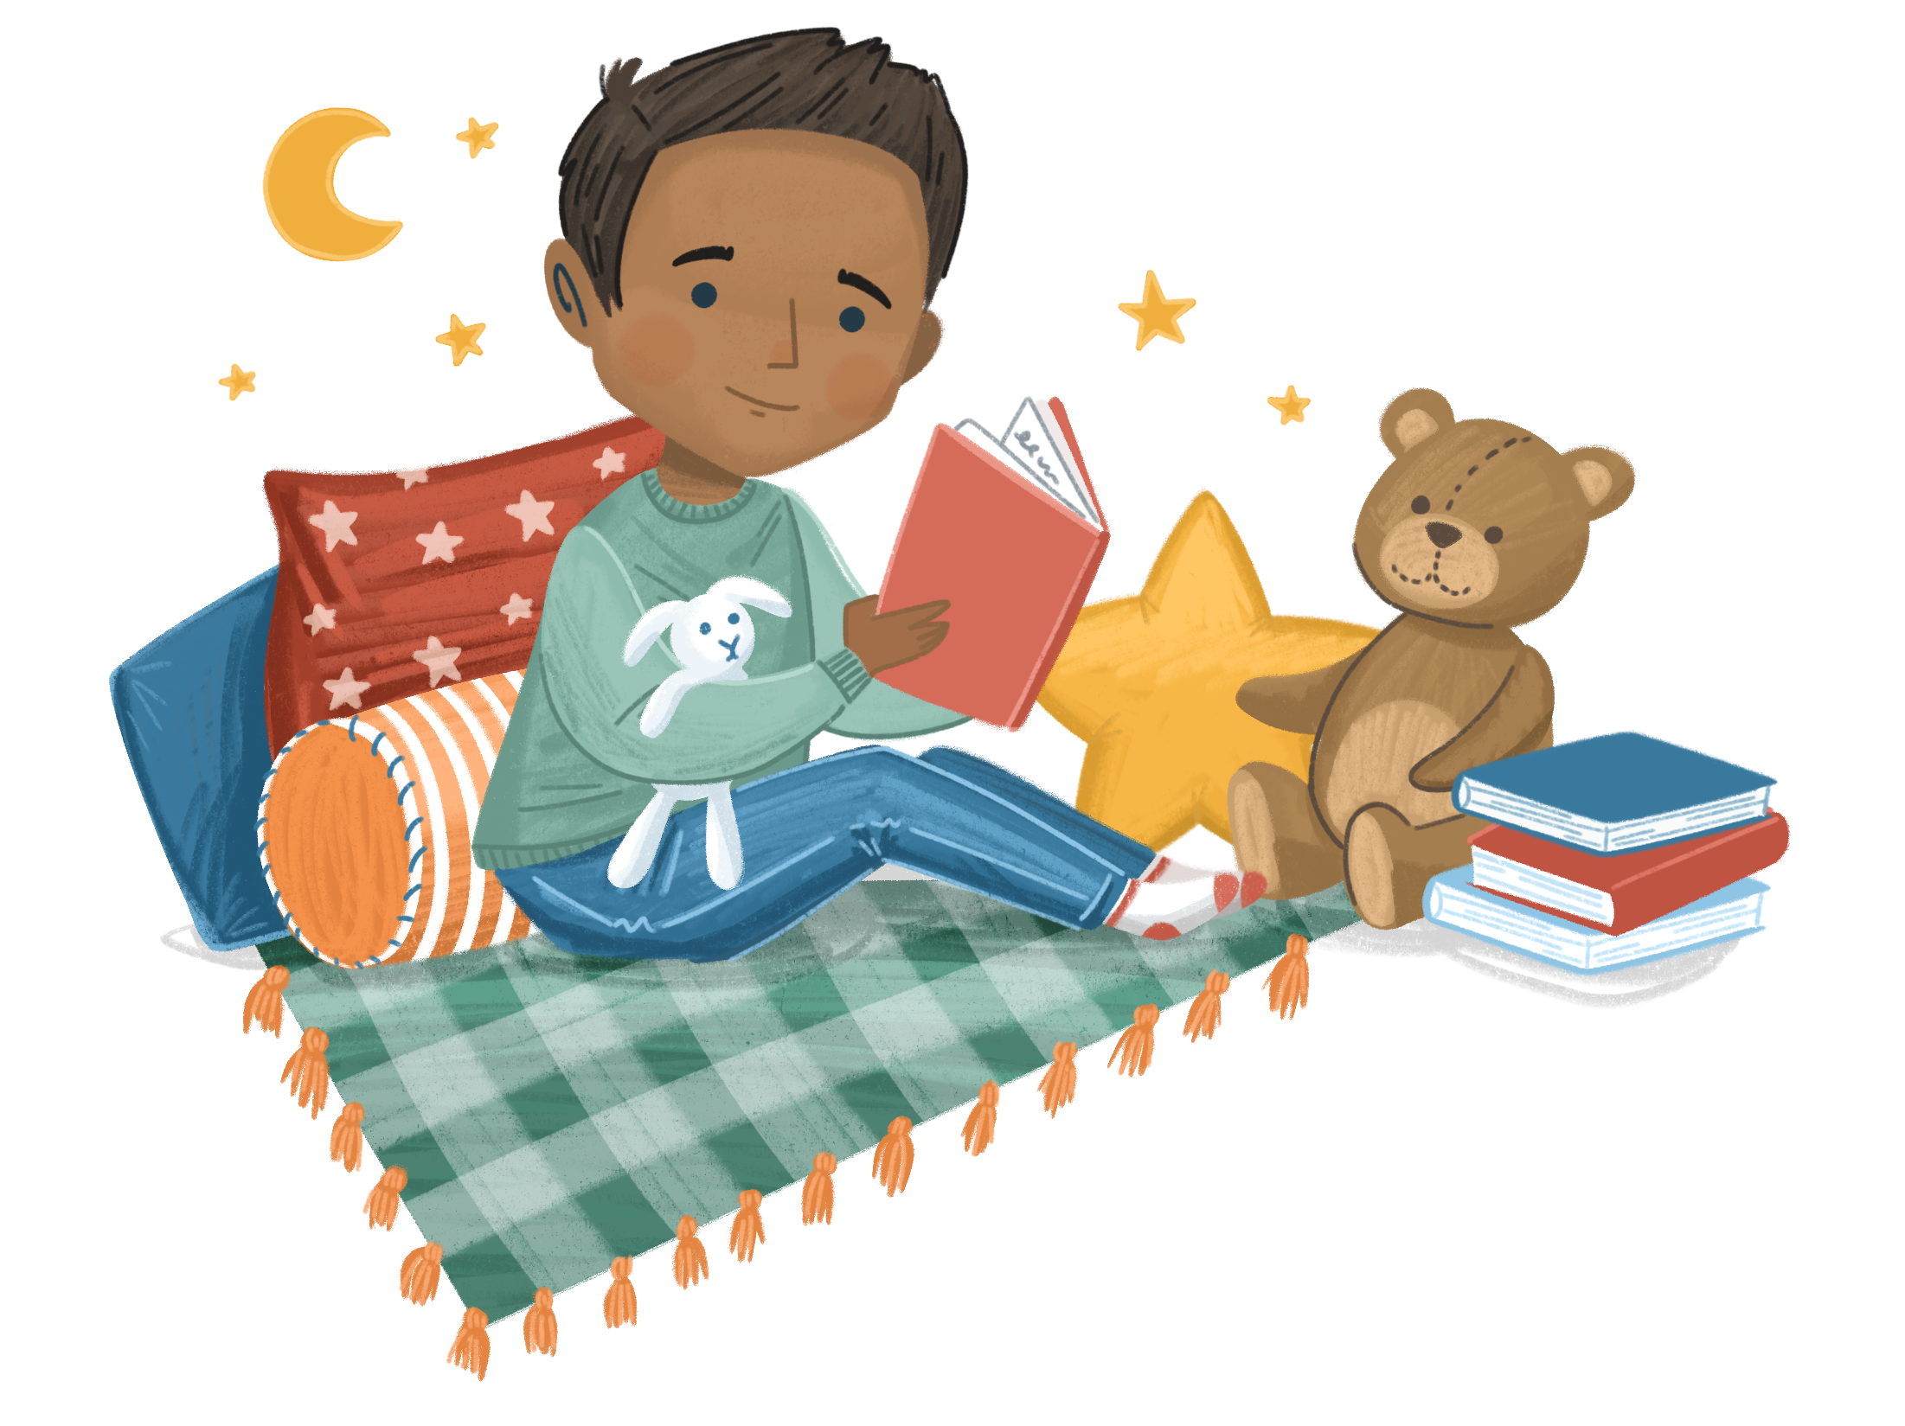
You choose!
ettle
Which was your favourite Settle activity from the last two lessons?
Use it to start your lesson today.
Notes:
Imaginary Hats
Hare Hug

Slide 26
Emotional Vocabulary
Which emotions and feelings have we found in the story?
Can you explain what each one means?
raining
Notes:
Which feelings and emotions have you covered
Can the children explain what each feeling and emotion means?
Can they give an example of when they have felt like that themselves?

Slide 27
I can explain how I welcome new people to my class.
I can explain how I show respect and kindness to others.
bjective
Notes:
Assessment opportunity of objectives

Slide 28
Summarise the Story
Can you summarise the story to your partner?
What were the key parts in the story?
ead

Slide 29
Class Discussion: Activity A
Follow the QR code to answer the questions together.
Discuss each question with your Talk Partner and then share your thoughts with your teacher.
Your teacher will summarise your answers and send them to The Story Project.
We love hearing your thoughts. Thank you!
ou
Notes:
Class discussion: Use the questions on the slides
Follow the QR code link to a learning evaluation form. There are 3 QR codes available – see below.
Depending on your class, you can either:
Read the questions to your class, give them time to think and then summarise their responses using QR 1
Read the questions to your class, discuss together and then let children answer the questions themselves using QR 2 on a device.
QR 3 is for adults only and allows staff to give their own feedback.

Slide 30
Class Discussion: Activity A
What was the best activity in this unit? Why?
Was there anything you didn’t enjoy about this unit? Why?
Have you learned anything in this unit that you didn’t already know?
Help us share your achievements!
Is there anything you have done or learning as part of this unit that you would like us to shout about on our social media?
ou
Notes:
Teacher to summarise pupil's responses
Activity A:
Read the questions on the screen with the class.
Give them some thinking time or time to discuss their responses with a Talk Partner.
Use QR code 1 to access the form. The teacher asks the questions to the class and summarises their responses.
Also available here: https://forms.office.com/Pages/ResponsePage.aspx?id=1UL-GCPYWkCGhoSj4l3oFrLryx4oVUtNoQjxq4TpQIZUNjNLMVJIUEI0UjFLWVRFSkoxUjE2V0NENC4u&origin=QRCode

Slide 31
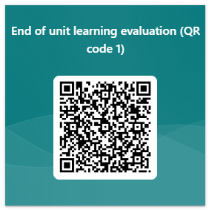
Class Discussion: Activity A
Click here to access QR Code 1 or scan below
ou
Notes:
Teacher to summarise pupil's responses
Activity A:
Read the questions on the screen with the class.
Give them some thinking time or time to discuss their responses with a Talk Partner.
Use QR code 1 to access the form. The teacher asks the questions to the class and summarises their responses.

Slide 32
Class Discussion: Activity B
Follow the QR codes to answer the questions.
There are separate questions for children and teachers (children will need their own devices).
Discuss each question with your Talk Partner before recording your answers.
We love to hear your thoughts. Thank you!
ou
Notes:
Children’s answers: https://forms.office.com/e/DK4mLcNjzN
Teacher’s answers: https://forms.office.com/e/XBuiMwBJex

Slide 33
Class Discussion: Activity B
What was the best activity in this unit? Why?
Was there anything you didn’t enjoy about this unit? Why?
Have you learned anything in this unit that you didn’t already know?
Help us share your achievements!
Is there anything you have done or learning as part of this unit that you would like us to shout about on our social media?
ou
Notes:
Children’s answers: https://forms.office.com/e/DK4mLcNjzN
Teacher’s answers: https://forms.office.com/e/XBuiMwBJex

Slide 34
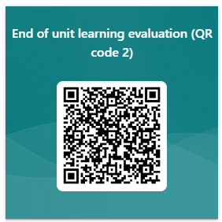
Class Discussion: Activity B
Children’s questions: Click here to access QR 2 or scan below
ou
Notes:
Use this link for children to submit their own answers

Slide 35
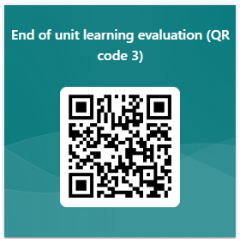
Class Discussion: Activity B
Teacher’s questions: Click here to access QR 3 or scan below
ou
Notes:
Use this link for teachers and other staff to submit their own responses

